Slide 1
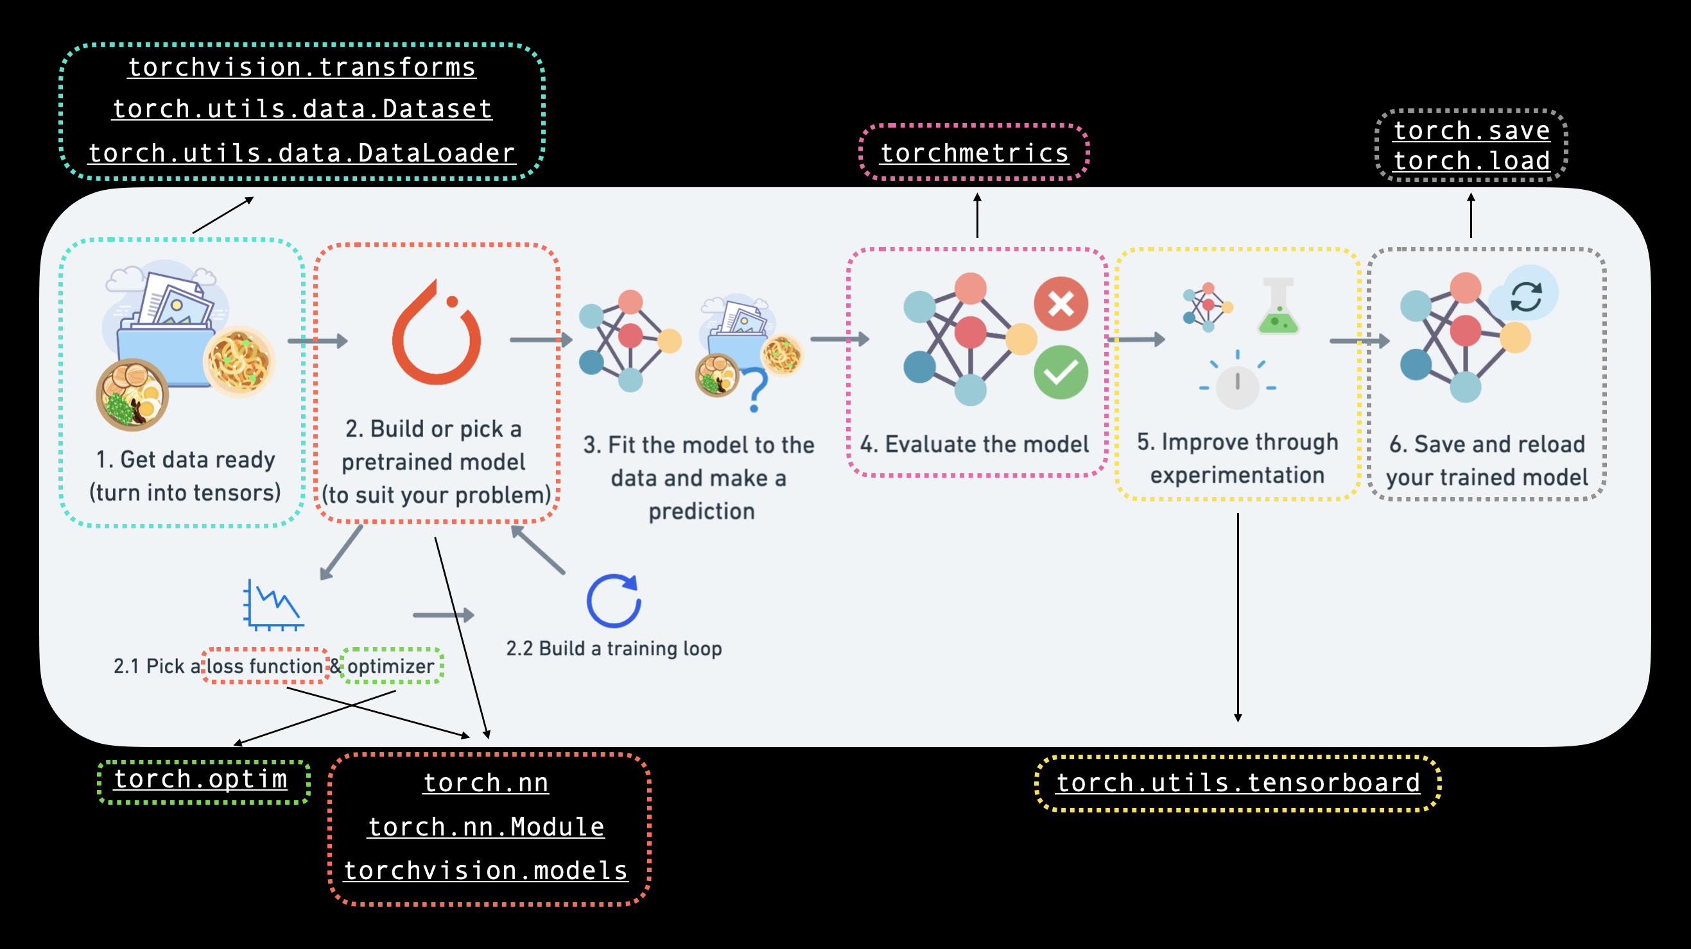
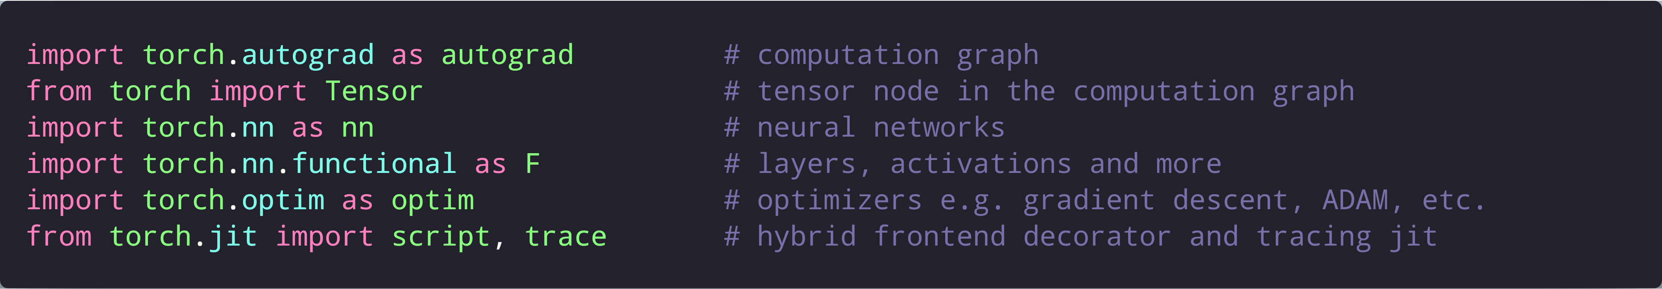
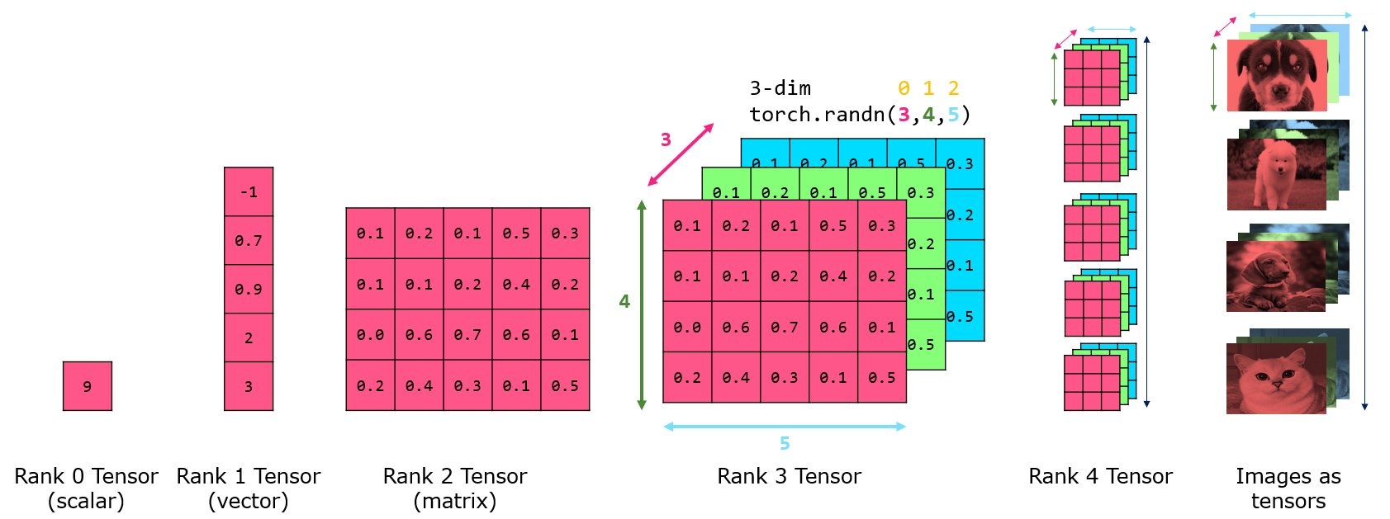
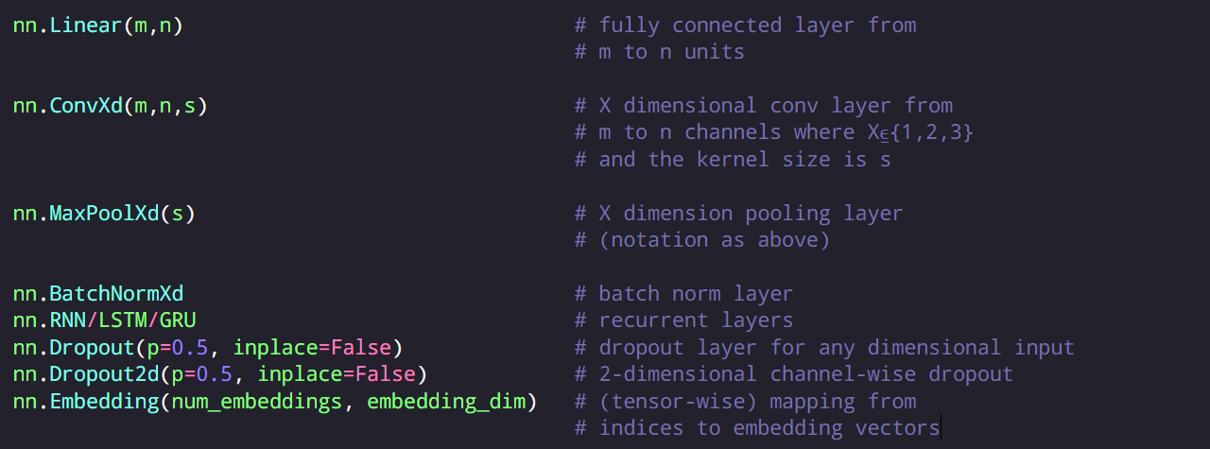
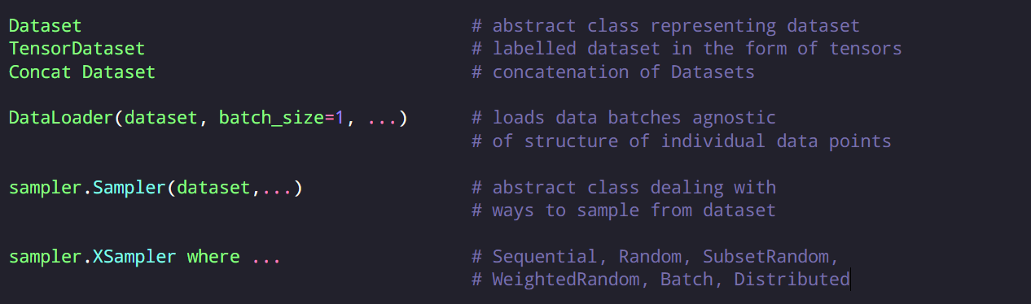
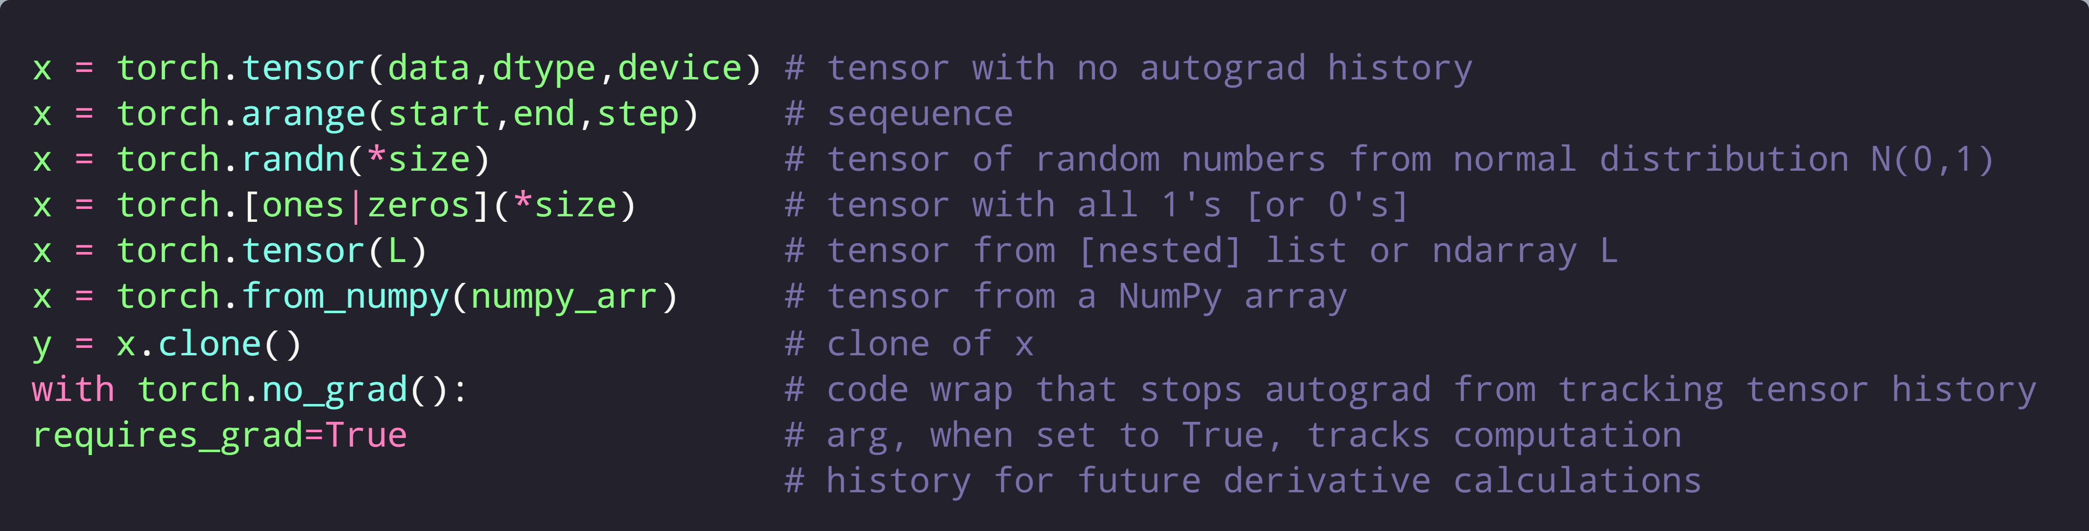
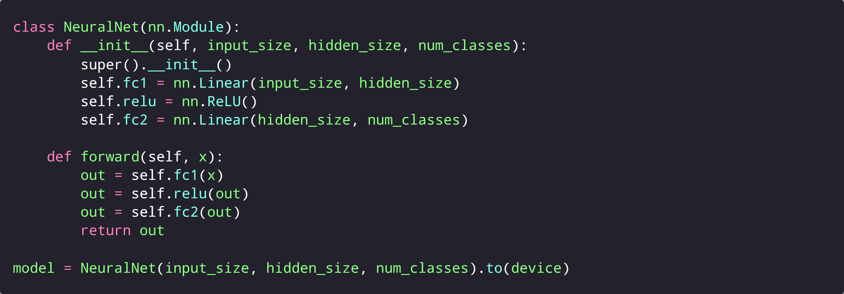
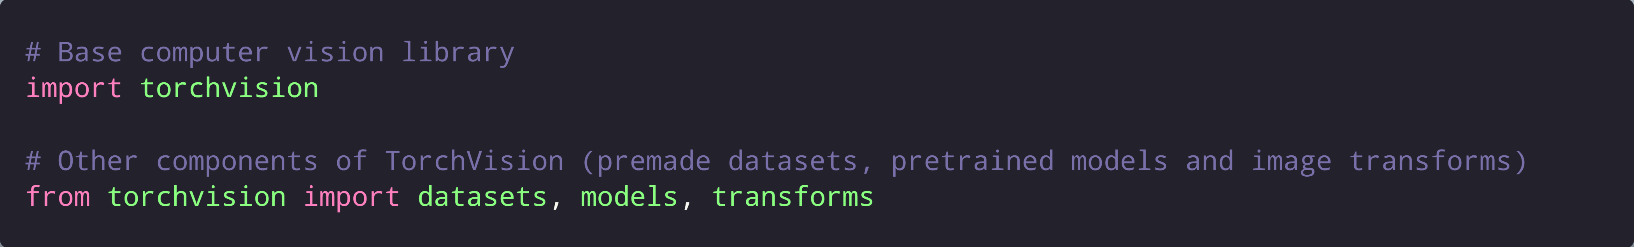
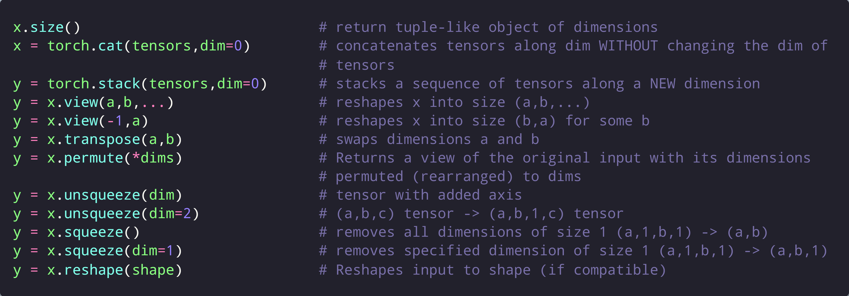
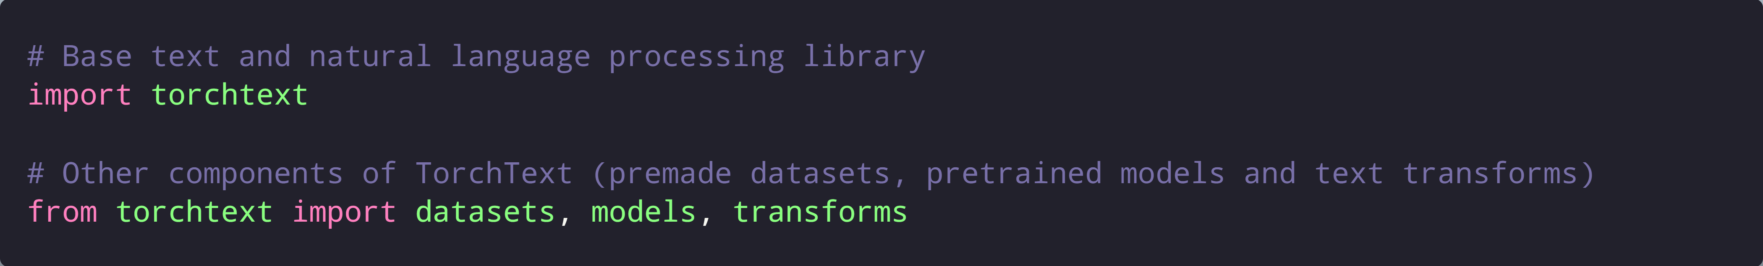
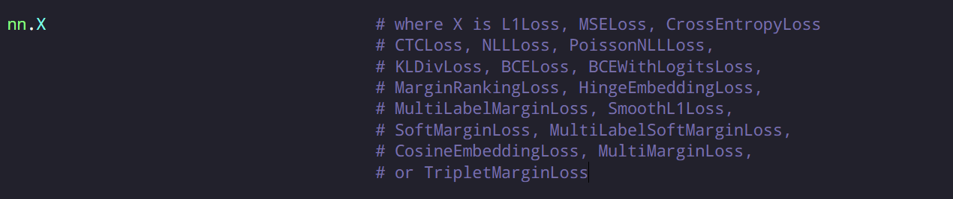
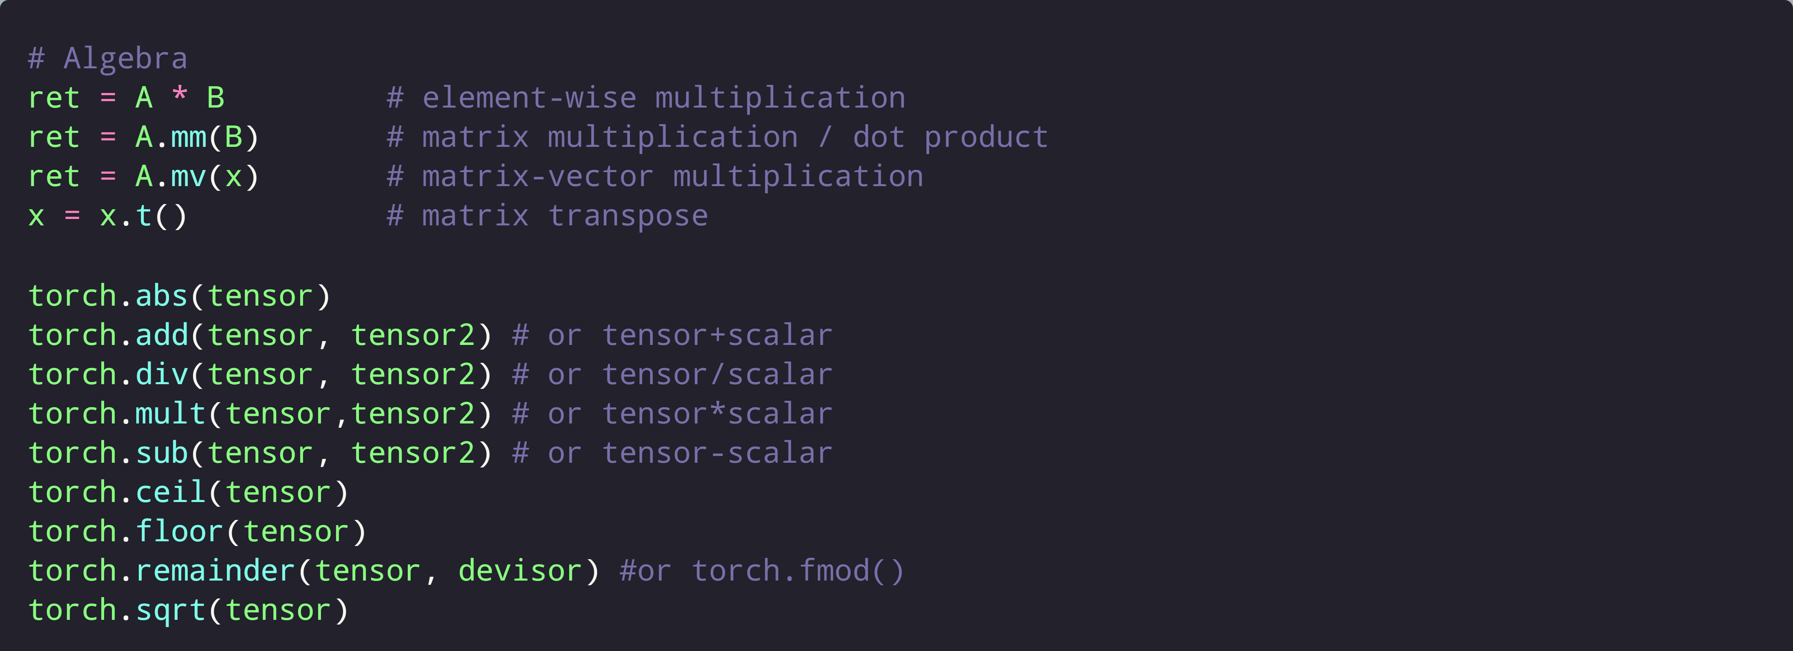
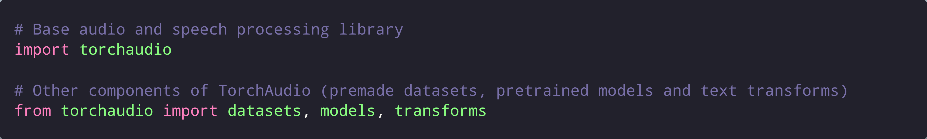
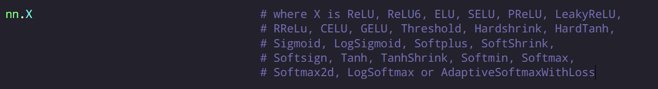
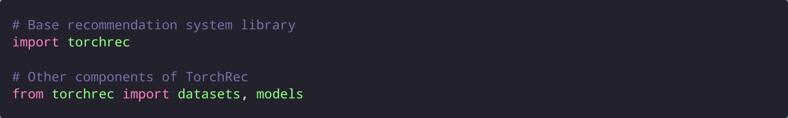
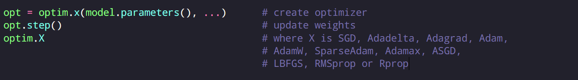
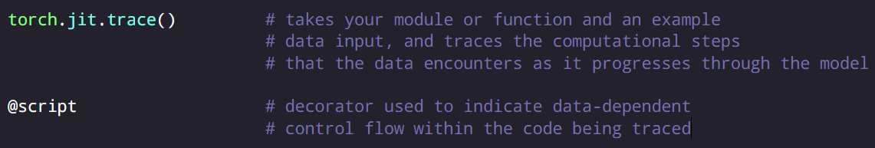
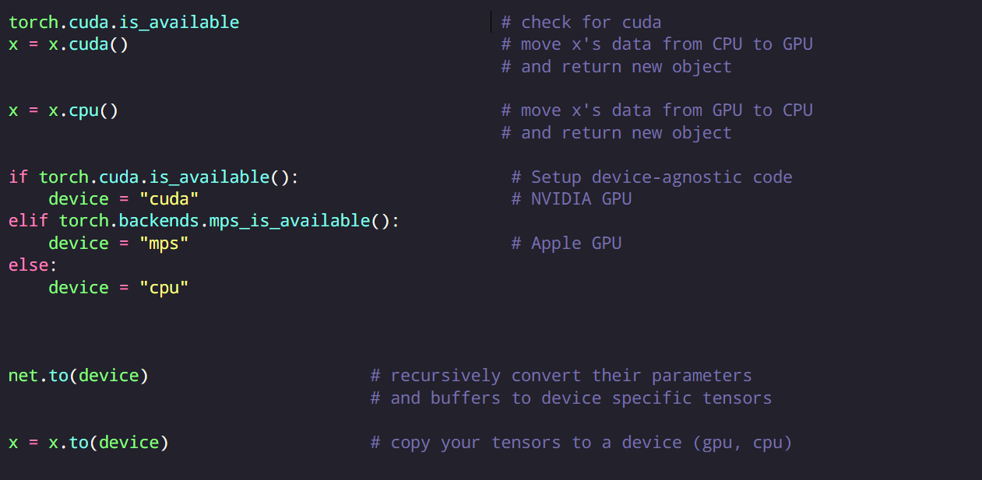
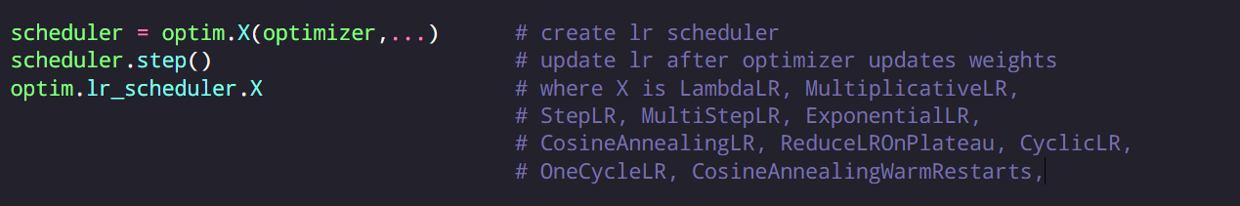
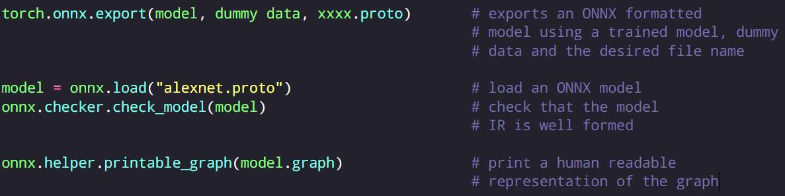

PyTorch CHEAT SHEET
Imports
PyTorch Workflow
Neural Network API
Deep Learning
Data Utilities
Tensors Creation
Model Building
Vision
Dimensionality
Text
Loss Functions
Audio and Speech
Math
Activation Functions
Recommendation systems
Optimizers
Torchscript and JIT
GPU Usage
Learning rate scheduling
ONNX
Distributed Training
Ahmad Alismail,
linkedin.com/in/ahmadalismail1
Last updated: 11/2022
PyTorch Workflow: Daniel Bourke https://github.com/mrdbourke/pytorch-deep-learning

Slide 2
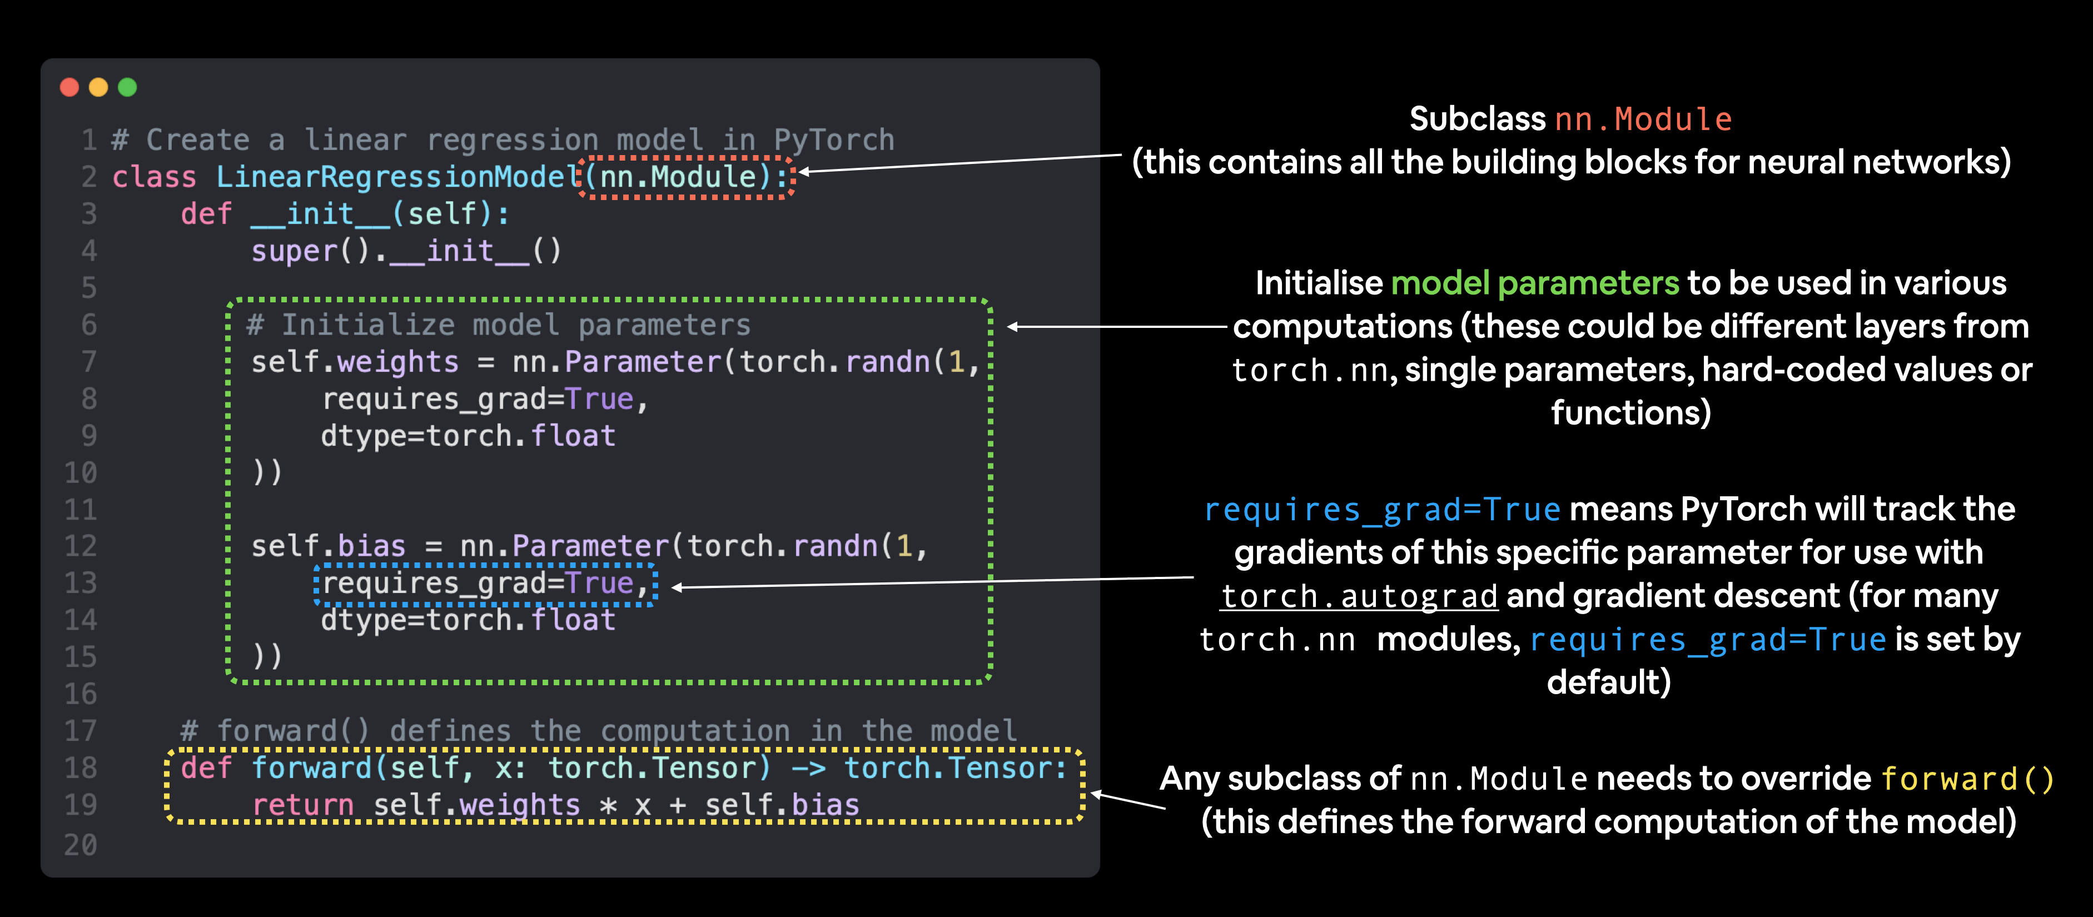
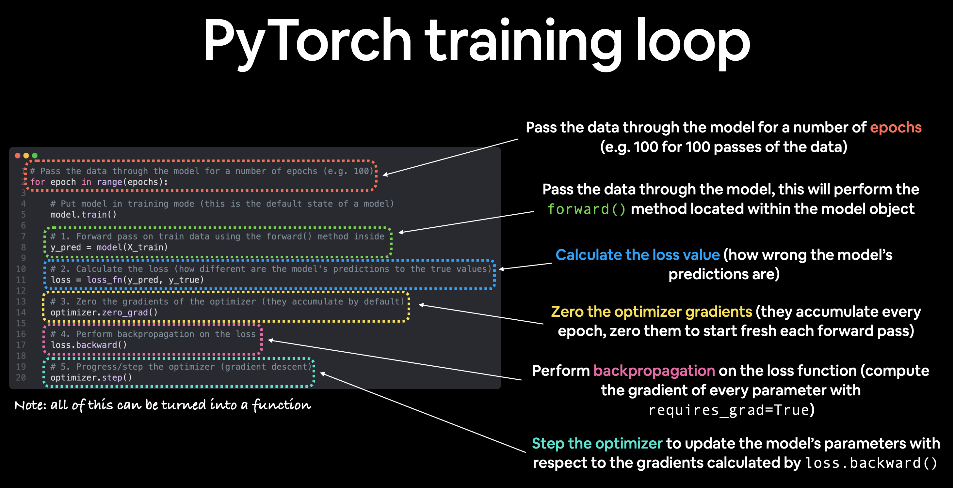
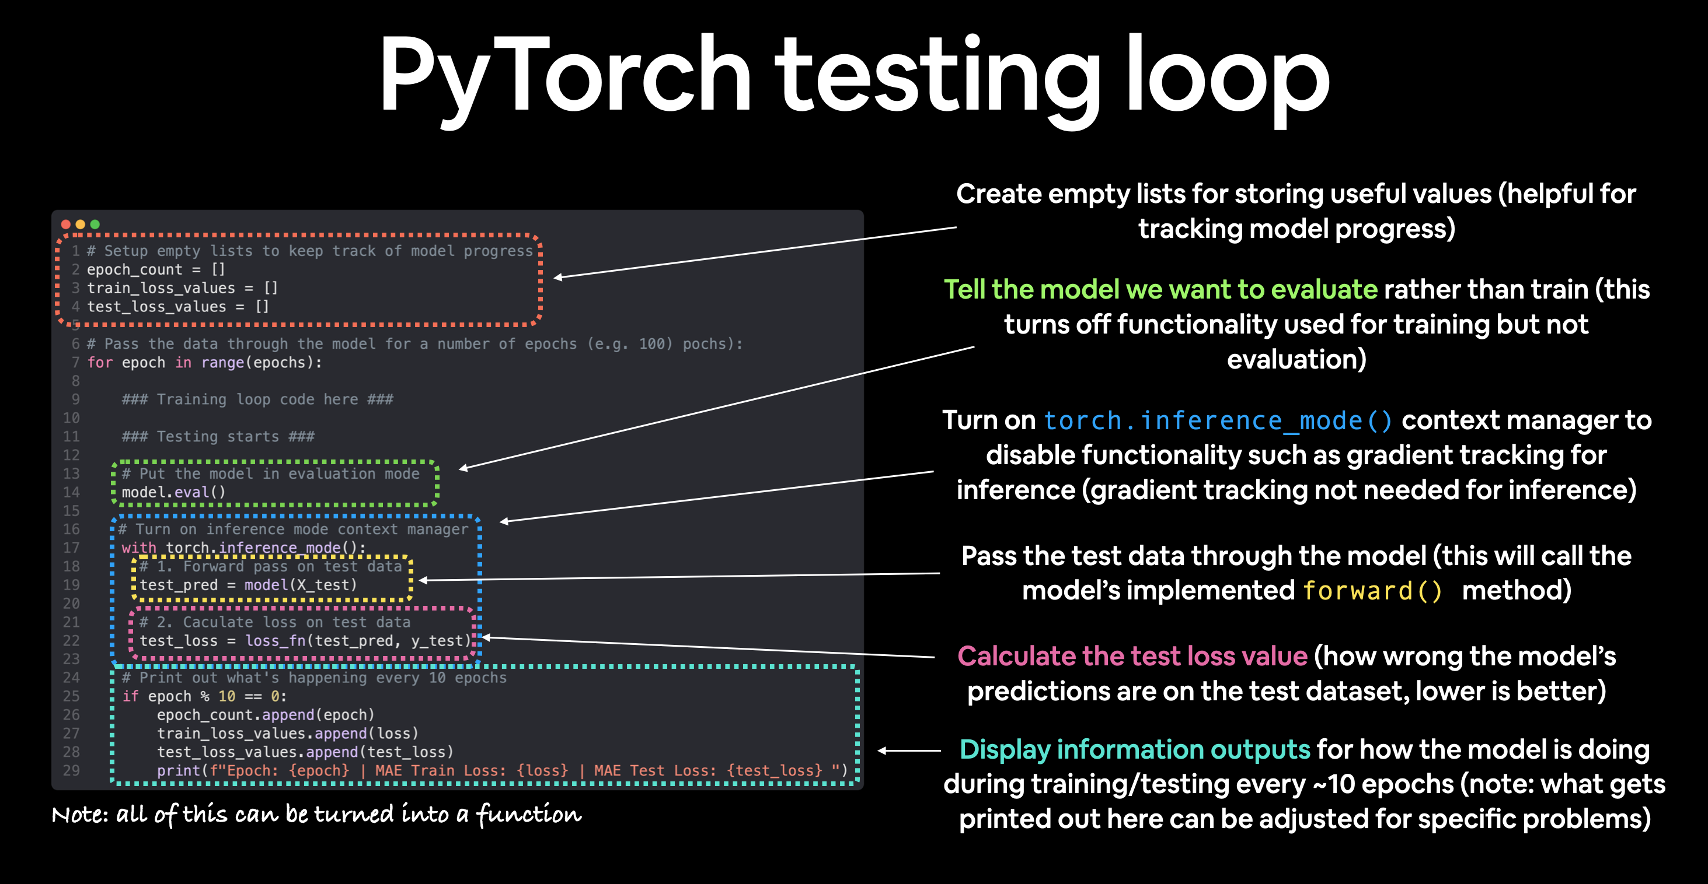
Get data ready
What shapes are my inputs and what shapes are my outputs? (All samples vs. Single sample)
PyTorch prefers to work with PyTorch tensors -> Turn data into tensors
Split our data into training and test sets
Build or pick a pretrained Model
Setting up device agnostic code (so our model can run on CPU or GPU if it‘s available)
Costructing a model by subclassing nn.Module
Create layers capable of handling X and y (considereing input and output shapes)
Define a forward method (make use of operator fusion to improve performance on GPU: return self.layer_3(self.relu(self.layer_2((x)))
Create an instance of the model and send it to target device
Create a loss function (a.k.a loss criterion)
Create an optimizer
Top PyTorch and DL Errors
Wrong datatypes: Your Model expected torch.float32 when your data is torch.uint8
Wrong data shapes: Your model expected [batch_size, color_channels, height, width] when your data is [color_channels, height, width]
Wrong devices: Your model is on the GPU but your data is on the CPU.
Load our data into PyTorch
Turn int into tensors (e.g., torchvision.transforms)
turn our raw images into Dataset's (features mapped to labels or X's mapped to y's) through torch.utils.data.Dataset
Turn our Dataset subsequently into DataLoader through torch.utils.data.DataLoader
Prevent Overfitting
Interpreting Learning Curve
Get more data
Use regularization
Simplify your model
Use data augmentation
Use transfer learning
Use dropout layers
Use learning rate decay
Use early stopping
Prevent Underfitting
Add more layers/units to your model
Tweak the learning rate
Use transfer learning
Train for longer
Use less regularization
PyTorch Training Loop
Put data on the available device X_train.to(device) (without this error will happen!)
Loop through epochs
Loop through training batches, perform training steps, caculate loss per batch.
Put model in training mode
Forward pass - The model goes through all of the training data once, performing its forward() function calculations (model(x_train)).
Calculate the loss - The model’s output/predictions (logits for classification if the loss function has a layer to convert logits to probabilities) are compared to the ground truth (labels) and evaluated to see how wrong they are (loss = loss_fn(y_pred, y_train).
Zero gradients - The optimizers gradients are set to zero (they are accumulated by default) so they can be recalculated for the specific training step (optimizer.zero_grad()).
Perform backpropagation on the loss - Computes the gradient of the loss with respect for every model parameter to be updated (each parameter with requires_grad=True). This is known as backpropagation, hence "backwards" (loss.backward()).
Step the optimizer (gradient descent) - Update the parameters with requires_grad=True with respect to the loss gradients in order to improve them (optimizer.step()).
DataLoader
DataLoader combines dataset and sampler
It helps load data into a model. For training and for inference.
It turns a large Dataset into a Python iterable of smaller chunks.
These smaller chunks are called batches or mini-batches and can be set by the batch_size parameter.
Why do this?
Because it's more computationally efficient.
PyTorch Testing Loop
Put the model in evaluation mode
Turn on torch.inference_mode() context manager to disable functionality such as gradient tracking for inference (since gradient trackingis not needed for inference)
All predictions should be made with objects on the same device (e.g. data and model on GPU only or data and model on CPU only), i.e., model.to(device) and X_test = X_test.to(device)
Pass the test data through the model. The model will generate logits (the raw outputs). Convert logits -> prediction probabilities (with sigmoid/softmax) -> predictions labels (with argmax(dim=1))
NOTE: call y_pred.cpu() on your target tensor to return a copy of your target tensor on the CPU because some libraries aren‘t capable of using data that is stored on GPU
Going Modular
One way to go from notebooks to scripts
Train a model built in a jupyter notebook with one line of code on the command line !python train.py
Create folder to store scrpits using os.makedirs()
Create the script using %%writefile folder_name/file_name.py

Slide 3
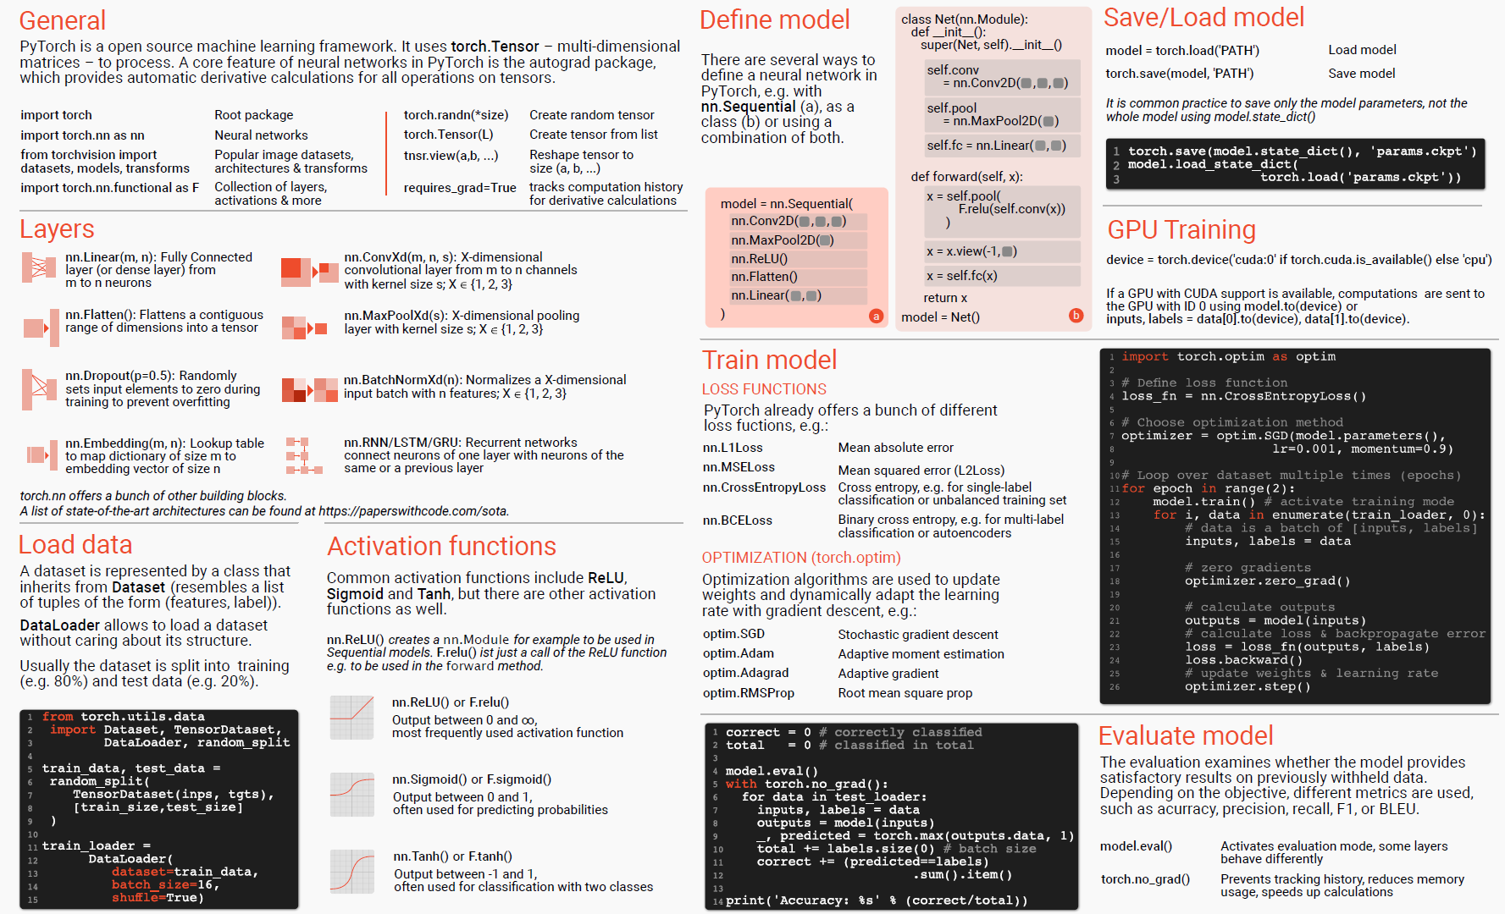

Slide 4
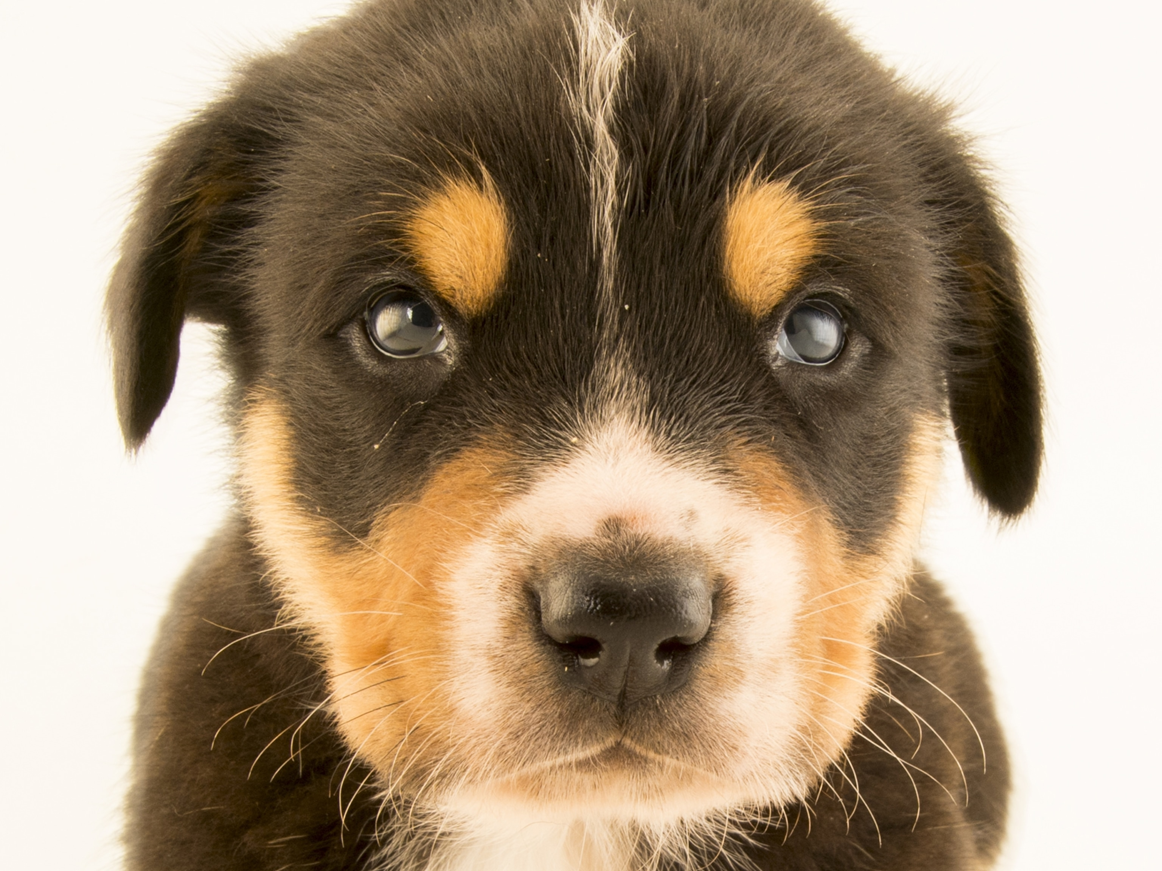
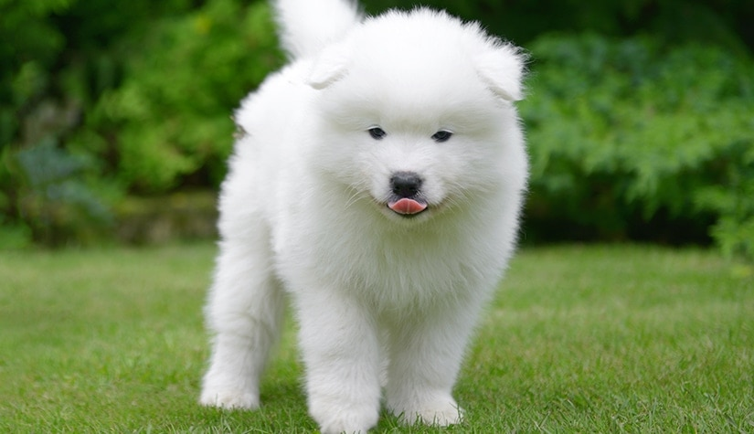
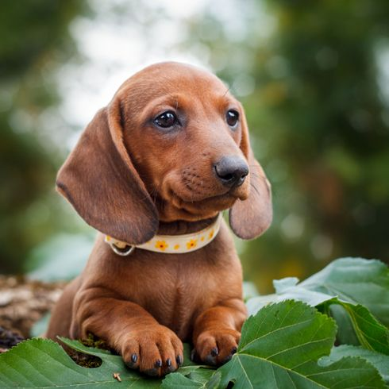

N-dim of tensor = # of square brackets [ on the left side
[batch_size, hight, width, color_channels] NHWC
# or
[batch_size, color_channels, hight, width] NCHW
3-dim 0 1 2
torch.randn(3,4,5)
3
0.1 | 0.2 | 0.1 | 0.5 | 0.3
0.1 | 0.1 | 0.2 | 0.4 | 0.2
0.0 | 0.6 | 0.7 | 0.6 | 0.1
0.2 | 0.4 | 0.3 | 0.1 | 0.5
-1
0.7
0.9
2
3
0.1 | 0.2 | 0.1 | 0.5 | 0.3
0.1 | 0.1 | 0.2 | 0.4 | 0.2
0.0 | 0.6 | 0.7 | 0.6 | 0.1
0.2 | 0.4 | 0.3 | 0.1 | 0.5
0.1 | 0.2 | 0.1 | 0.5 | 0.3
0.1 | 0.1 | 0.2 | 0.4 | 0.2
0.0 | 0.6 | 0.7 | 0.6 | 0.1
0.2 | 0.4 | 0.3 | 0.1 | 0.5
0.1 | 0.2 | 0.1 | 0.5 | 0.3
0.1 | 0.1 | 0.2 | 0.4 | 0.2
0.0 | 0.6 | 0.7 | 0.6 | 0.1
0.2 | 0.4 | 0.3 | 0.1 | 0.5
4
9
5
Rank 0 Tensor (scalar)
Rank 1 Tensor (vector)
Rank 2 Tensor (matrix)
Rank 3 Tensor
Rank 4 Tensor
Images as tensors

